Slide 1
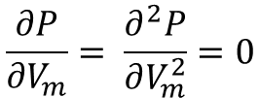
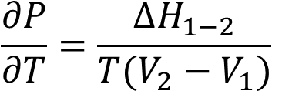




$$\frac{∂P}{∂V_{m}}= \frac{∂^{2}P}{∂V_{m}^{2}}=0$$
$$ΔQ_{reçu}=Ri^{2}Δt$$
$$ΔH_{1−2}=Q_{recu}=−ΔH_{2−1}$$
$$S_{e}=\int{\frac{δQ}{T_{ext}}}=\frac{ΔH}{T}$$
$$L=|ΔH_{1−2}|$$
$$\frac{∂P}{∂T}=\frac{ΔH_{1−2}}{T(V_{2}−V_{1})}$$

Slide 2
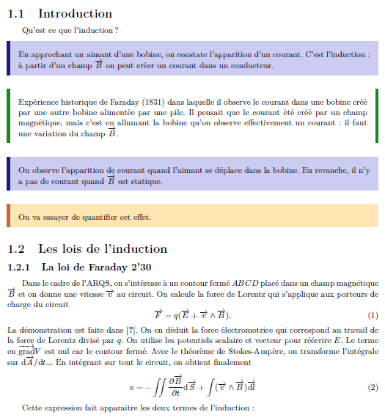

Slide 3
